Slide 1
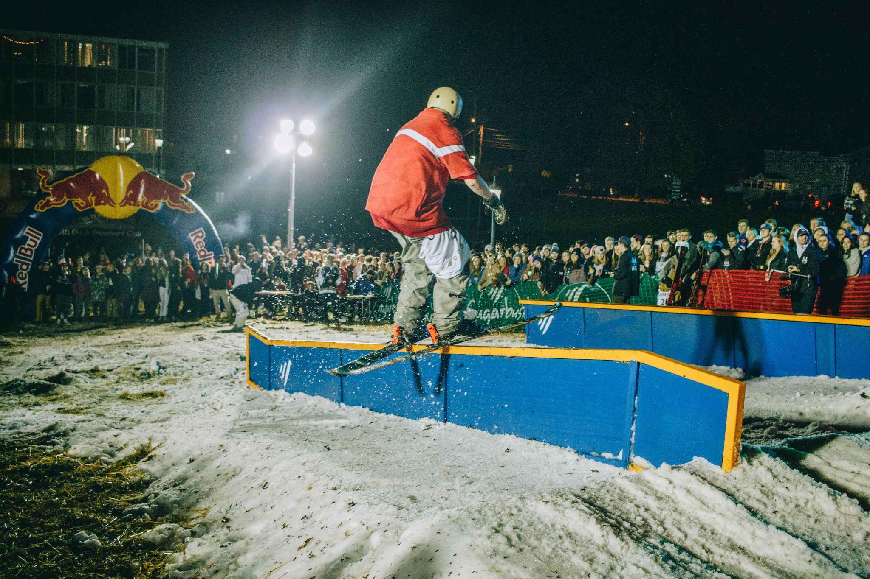
UVM Ski & Snowboard Club
First General Meeting
2021

Slide 2
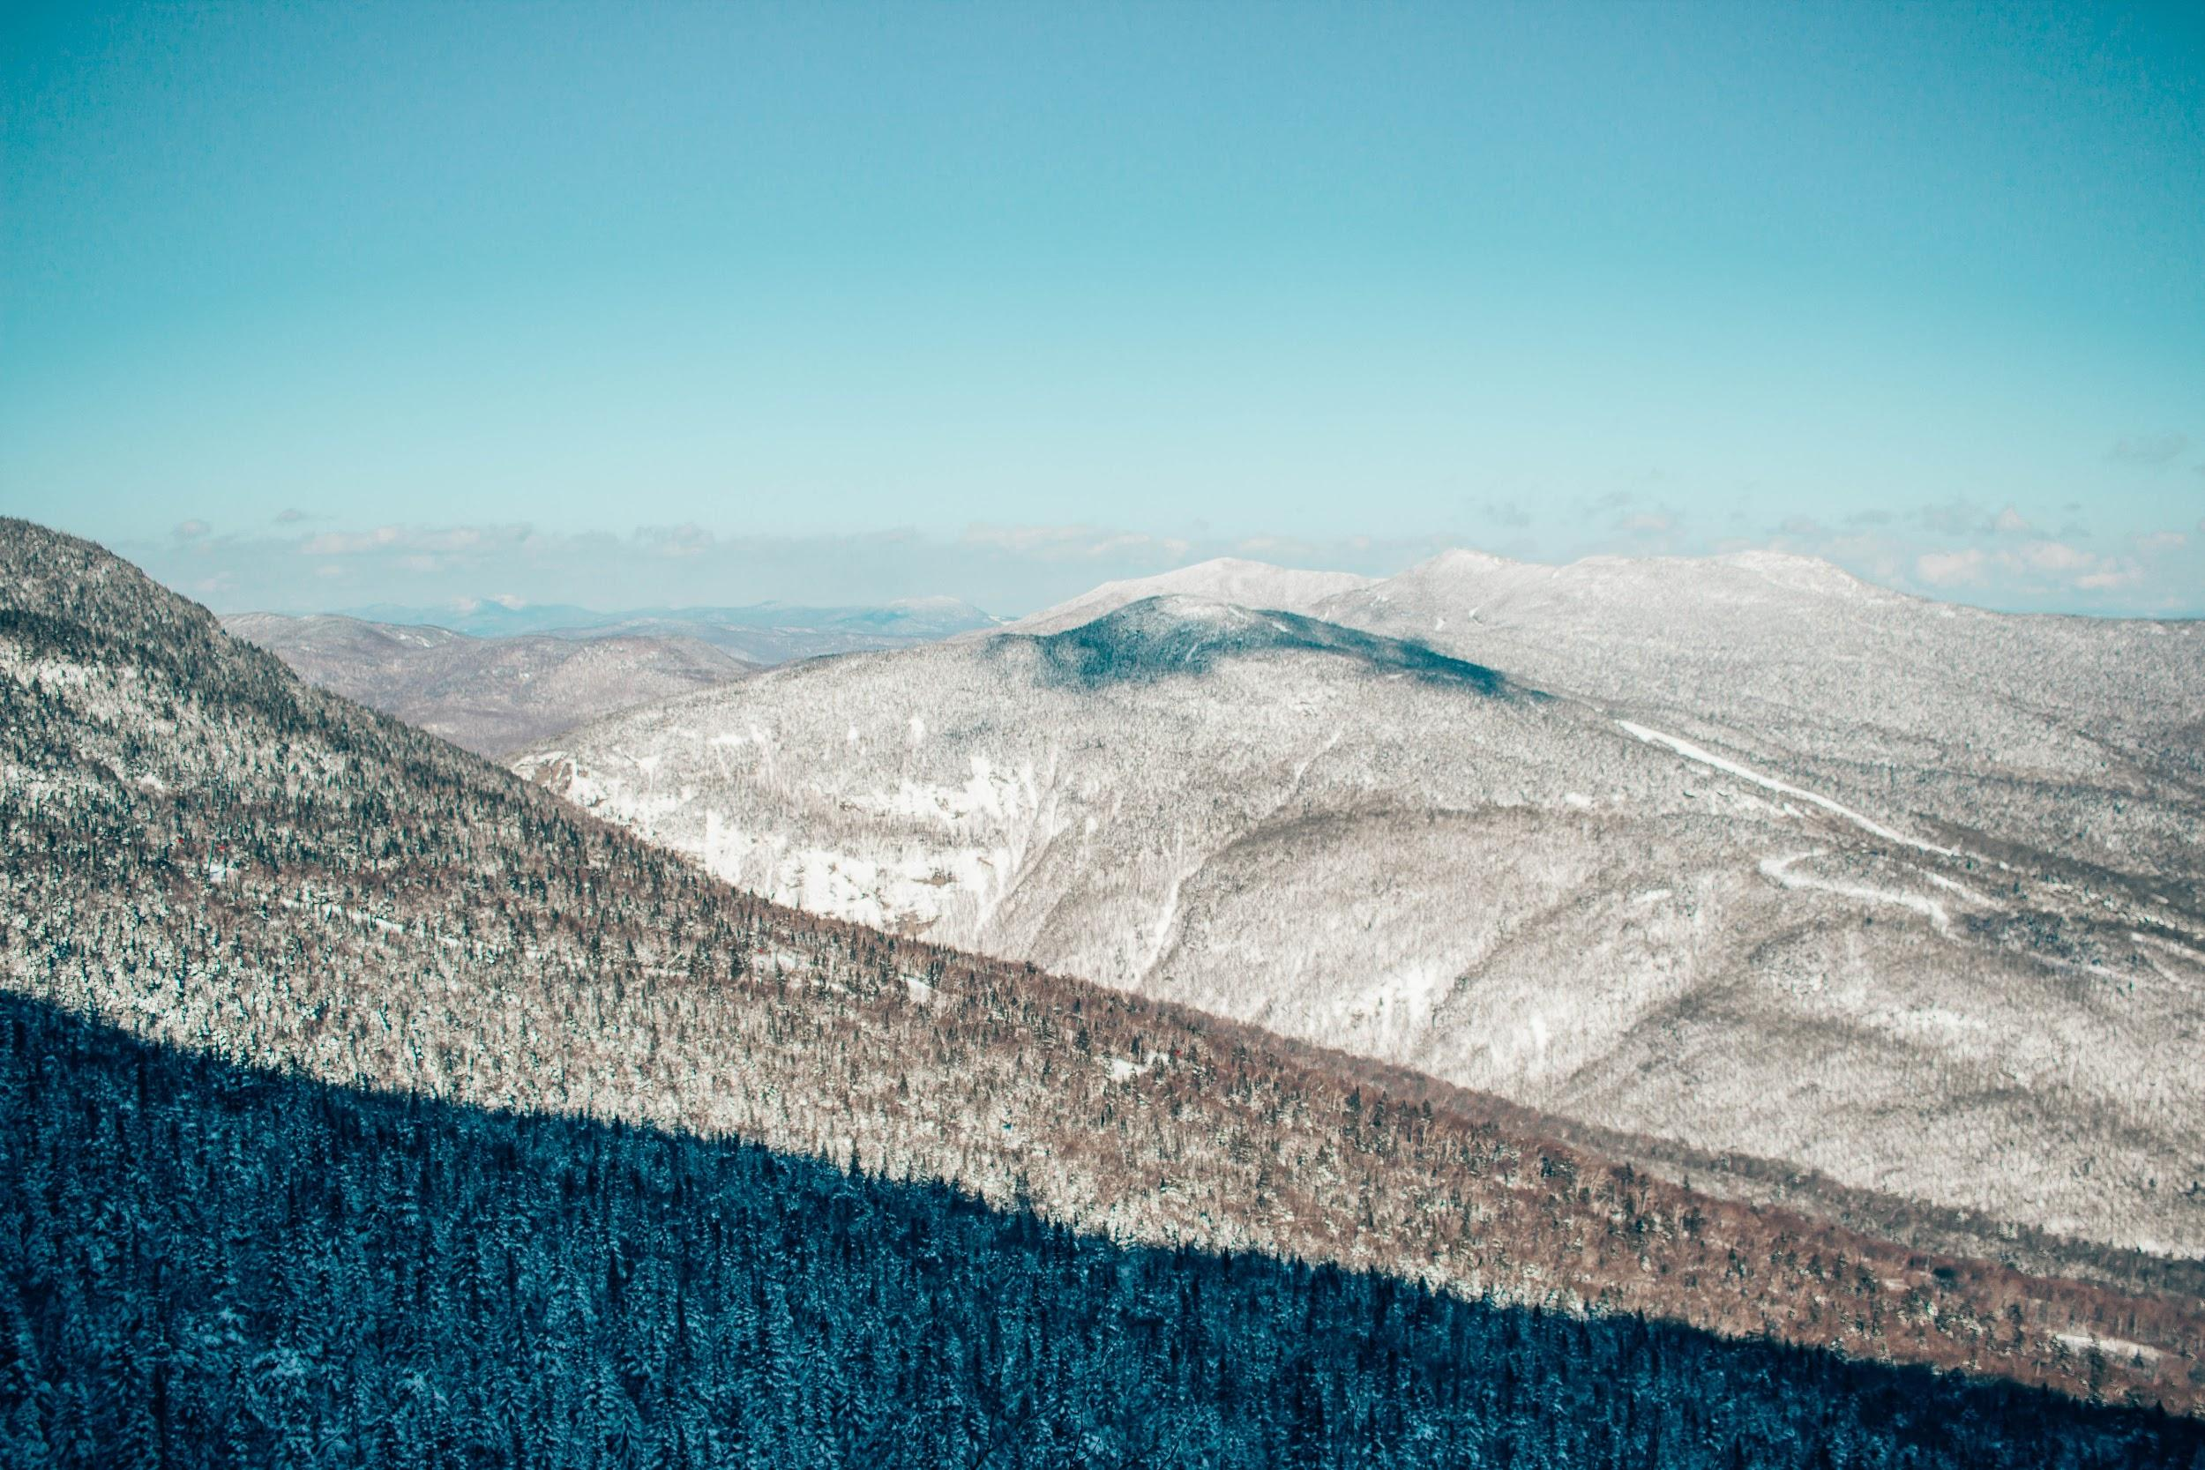

Slide 3
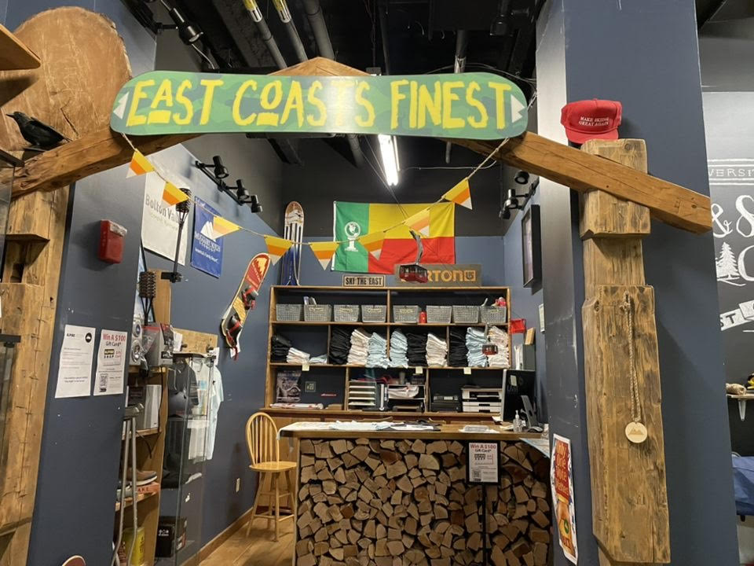
UVMSSC Clubhaus
Open Monday-Friday 10am-4pm
No capacity limit this year!
A place where you can...
Buy Passes
Sign-Up for busses
Ask any questions you may have
Hang out, terminally chill

Slide 4
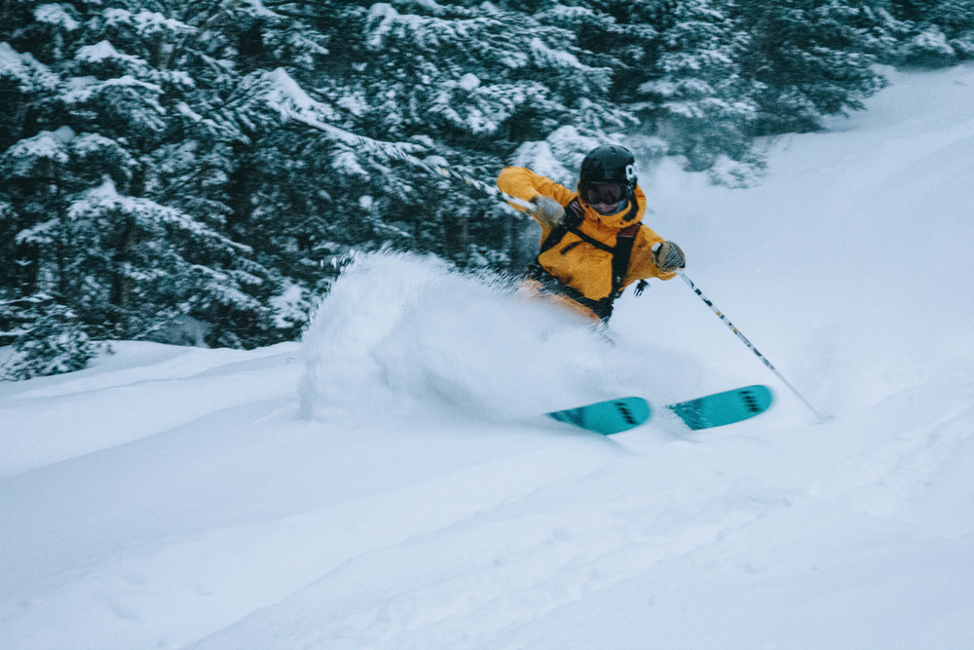
Find us on Social Media & Online
https://www.uvmssc.org/
Follow us on Instagram! @uvm_ssc
UVMSSC Member Forum -- Facebook Member Forum
Tag or DM us when you hit the slopes to be featured!!
Know of some cool stuff happening in the industry? You land a sick job? Go on a rad trip? Tell us about it and we’ll write about you on our blog!

Slide 5
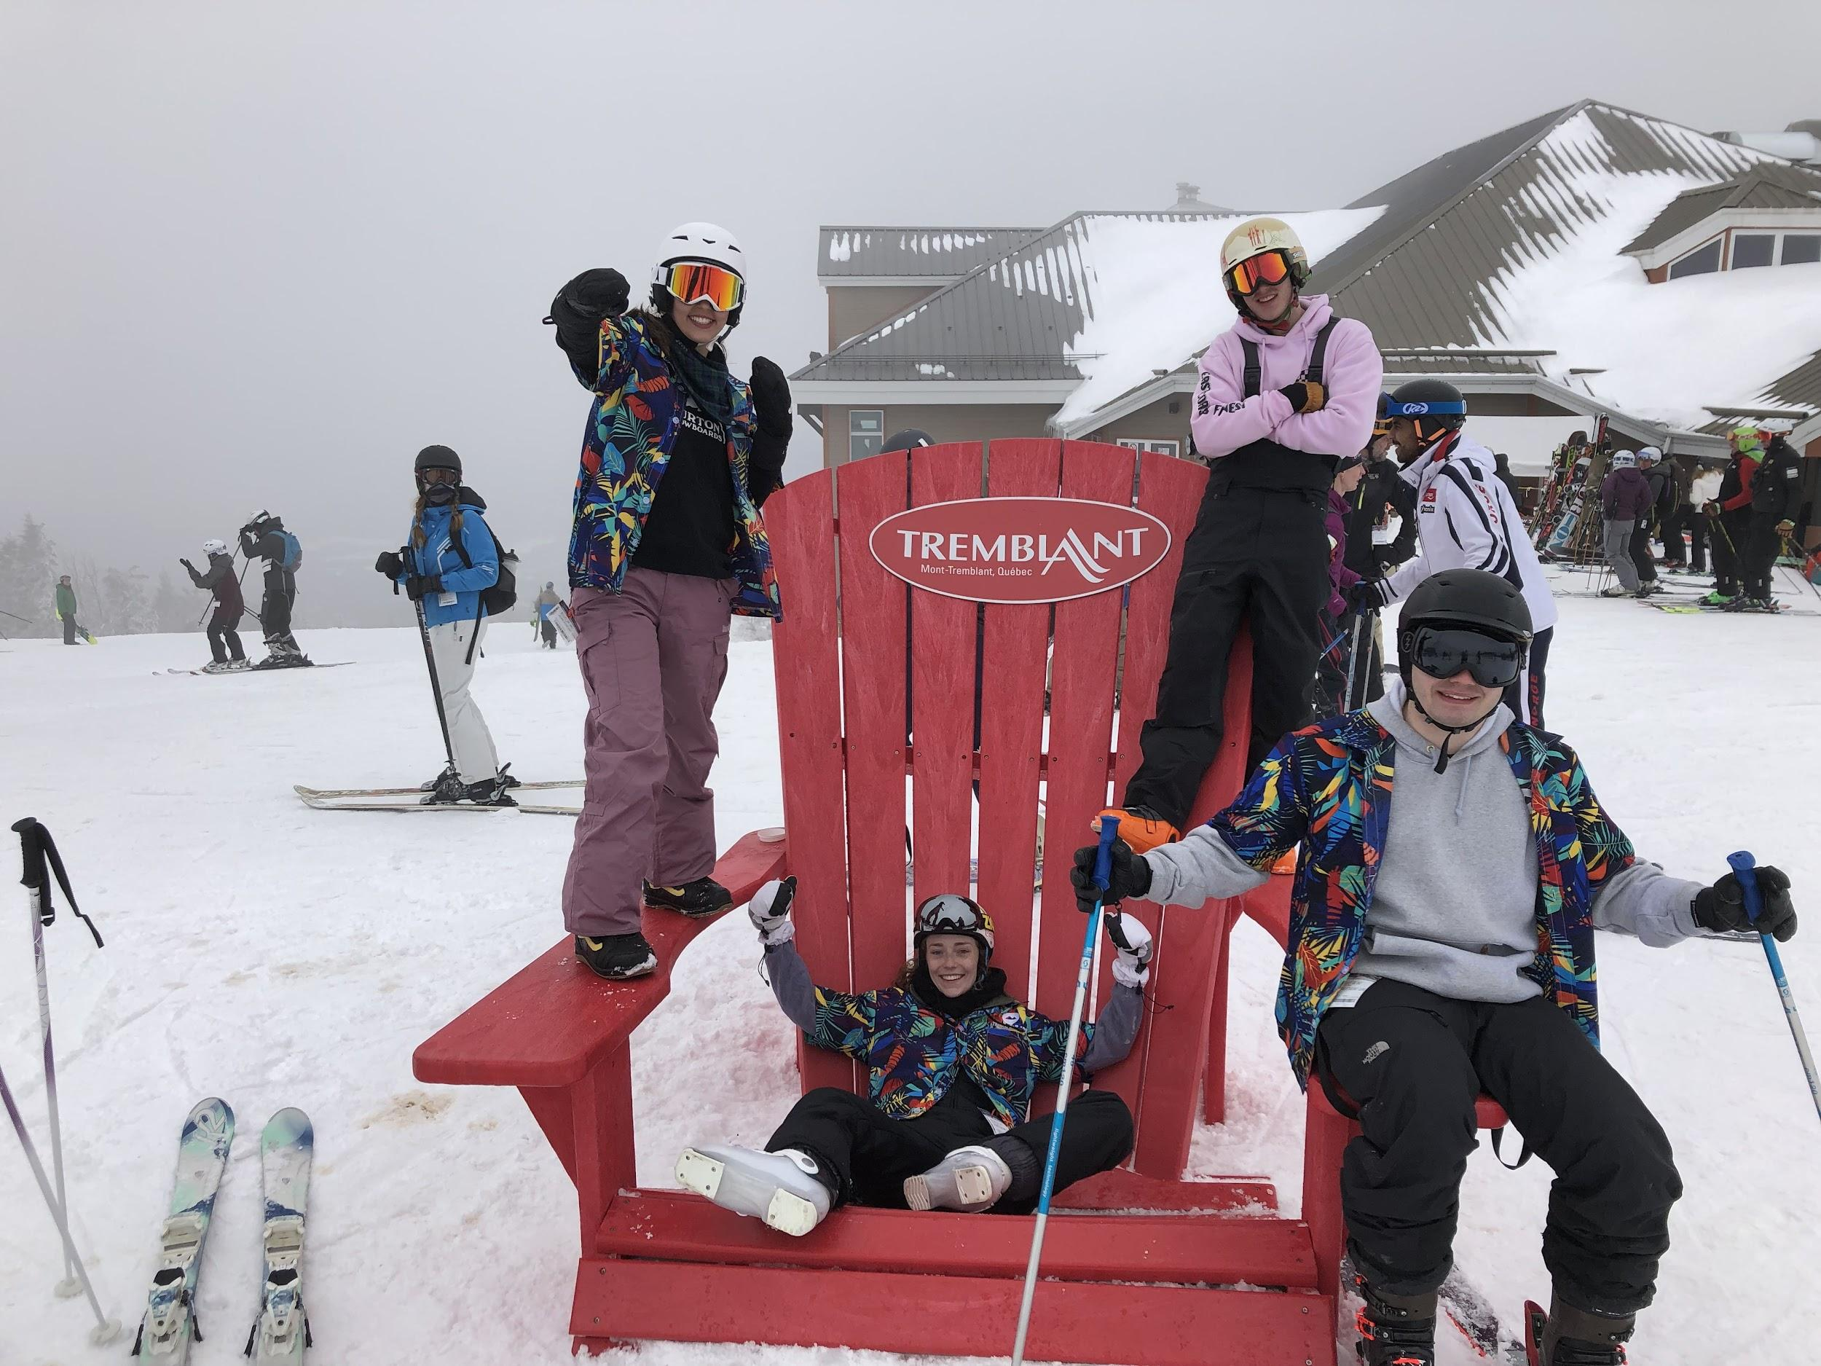
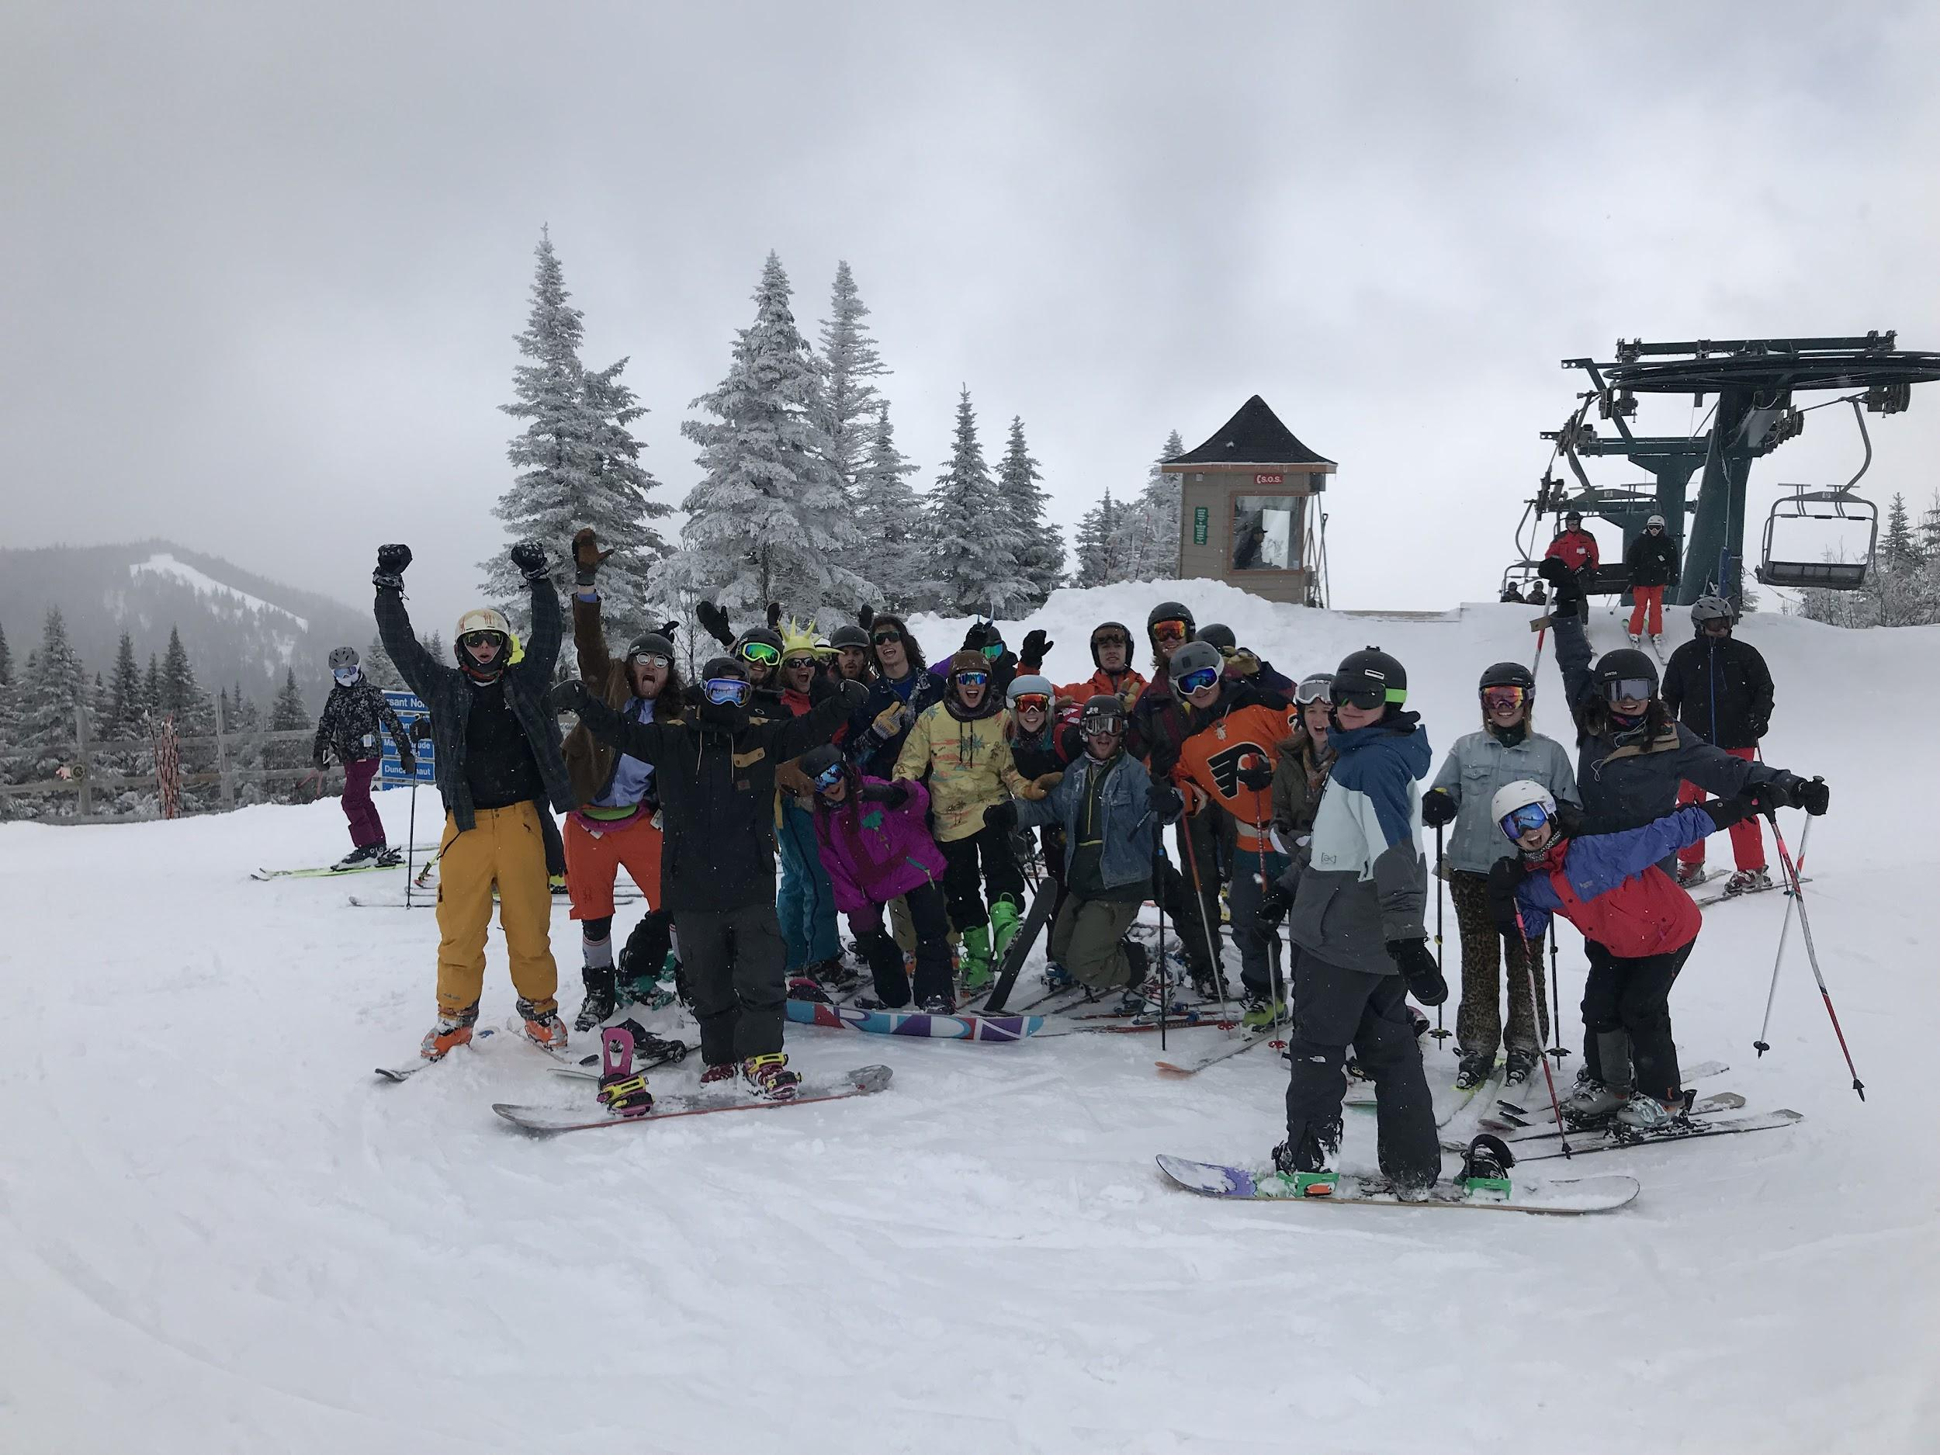
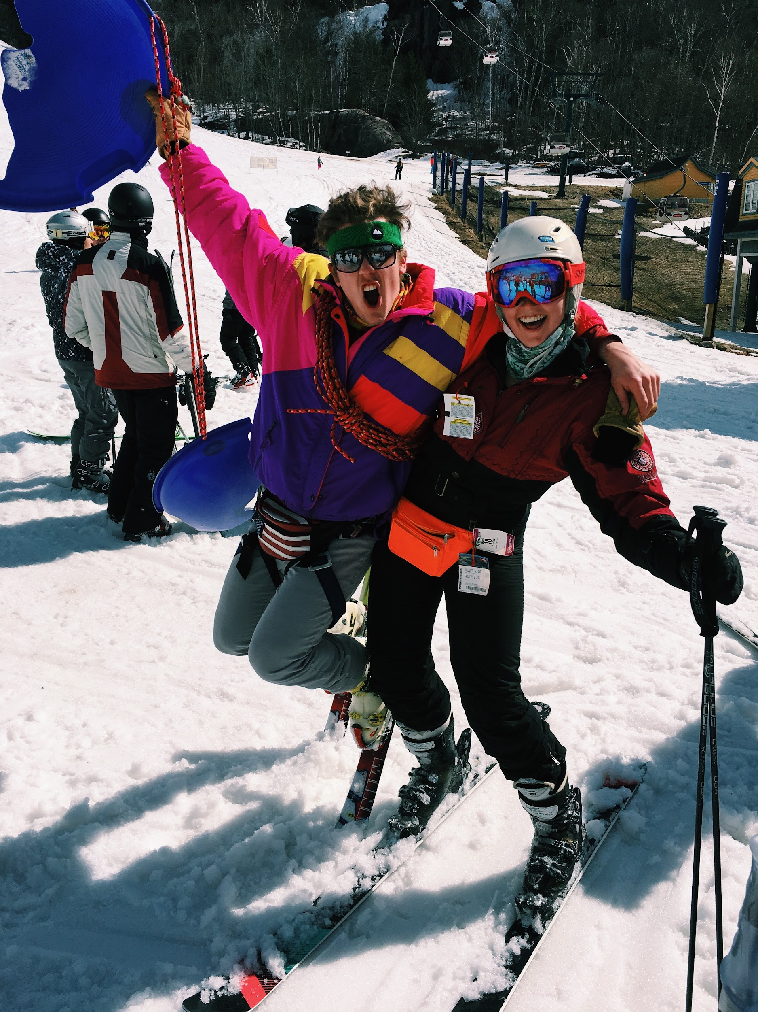
More trips to come...
Didn’t get onto the Steamboat Trip? No worries, more trips to come! Look out for emails about the Spring Break Trip and Tremblant!

Slide 6
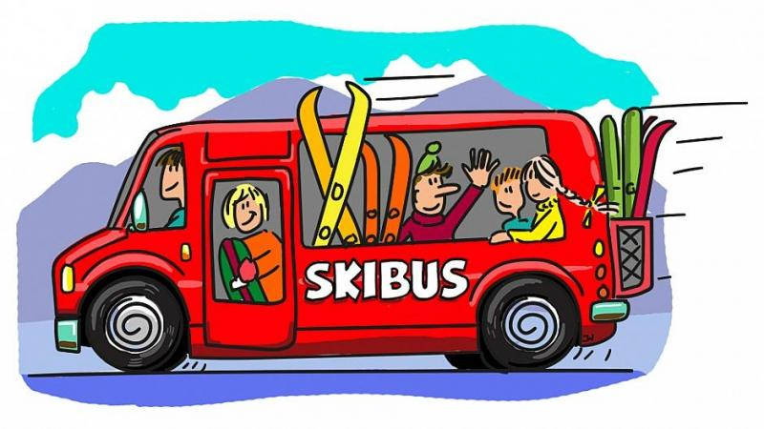
Need A Hitch to the Hill?
-Sign-ups go live on our website each Wednesday for the following weekend.
ALL BUSSES meet at Patrick Gym at 8:45. Depart at 9:00 am. Busses will run regularly at the start of second semester- Mid April to Smuggs, Jay, Sugarbush, and Mad River
Additional Pick Ups at Trinity & Central @ 8:30am.

Slide 7
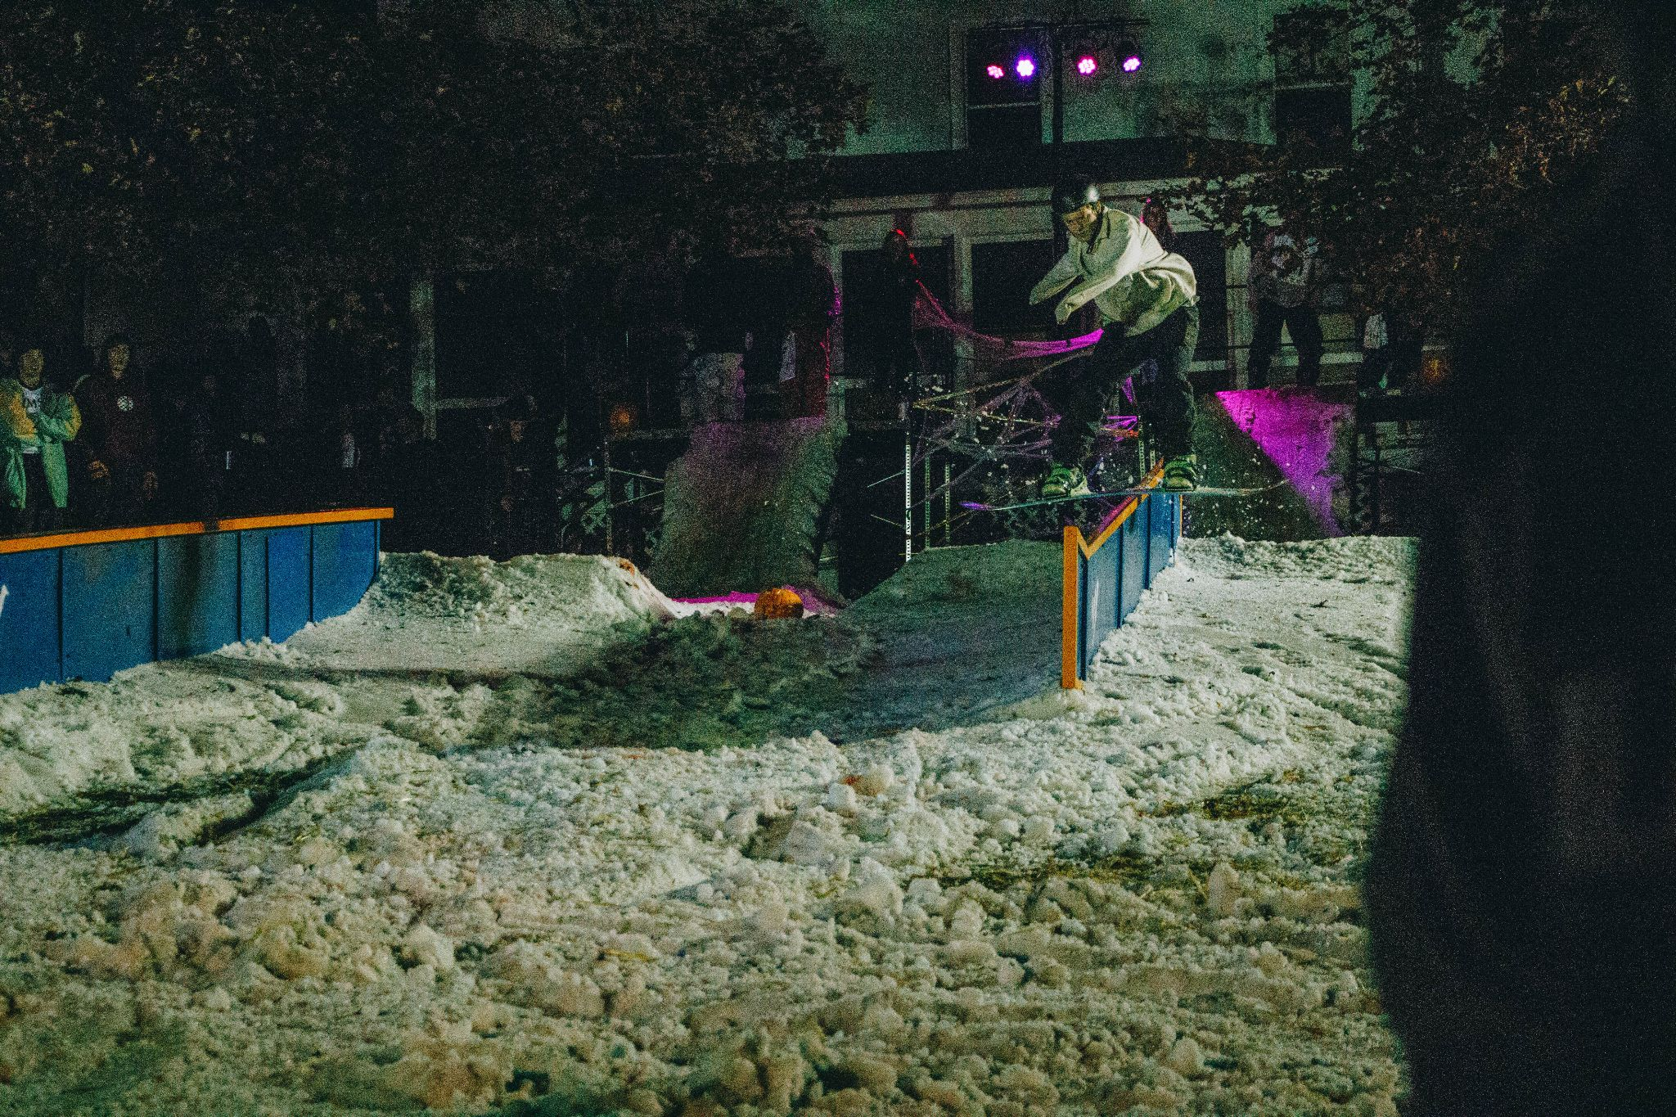
Dawn of the Shred: XIII
What: On-Campus Rail Jam
Where: Trinity Campus
When: End of October
-Sign-Ups will be in the clubhaus, starting two weeks before the competition.
-If you wanna help out with the event then lets us know at the clubhaus!

Slide 8
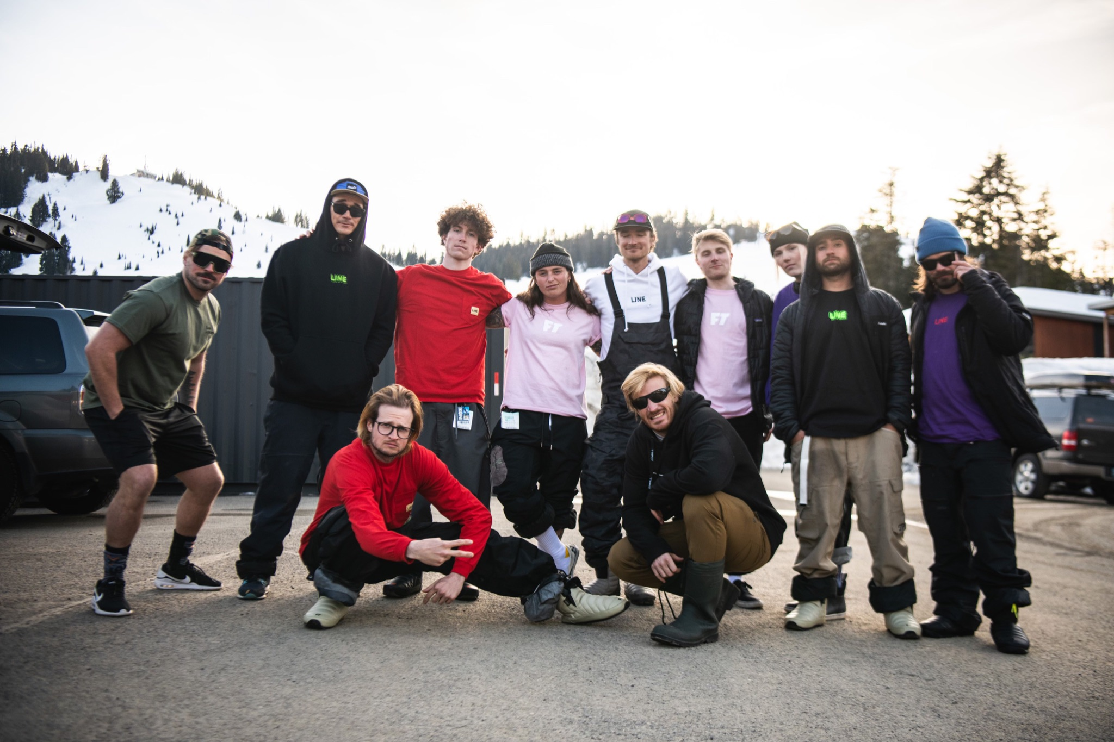
LINE Skis Insta Contest
Follow LINE Skis @lineskis
Comment on their most recent post tagging @uvm_ssc and @lineskis
3 Winners will be picked by the end of the night to win free gear

Slide 9
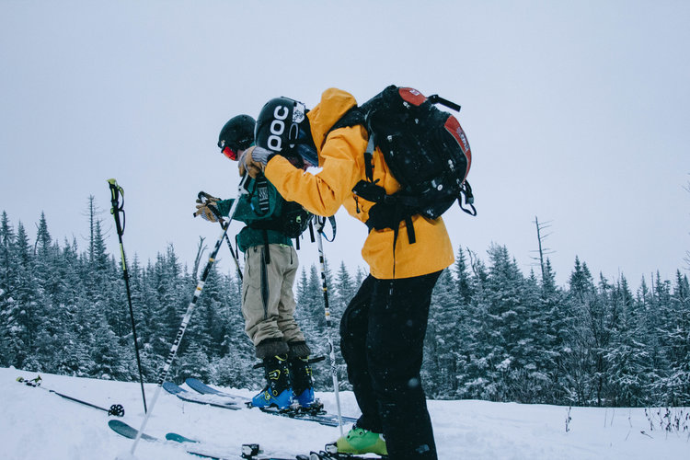
Homegrown 2022
What: On-campus film festival featuring member’s season edits
Where: Harris Millis Amphitheater, Athletic Campus
When: Late April
- Start collecting your footy in the early season!
- Must be no longer than 4 minutes and 20 seconds
- Must feature more people than just yourself

Slide 10
Alpine Shop, Burton & Skida Shop Nights
Where: 1184 Williston Rd, South Burlington, VT
When: End of October-ish
-30% off for all UVMSSC members
-Great way to meet other members
Where: 162 College Street, Burlington, VT
When: October 16th and 17th
-25% of for all members
-They have great dogs
Where: 16 Kilburn St #116, Burlington, VT
When: End of October-ish
-20% off storewide
-After hours private SSC event

Slide 11
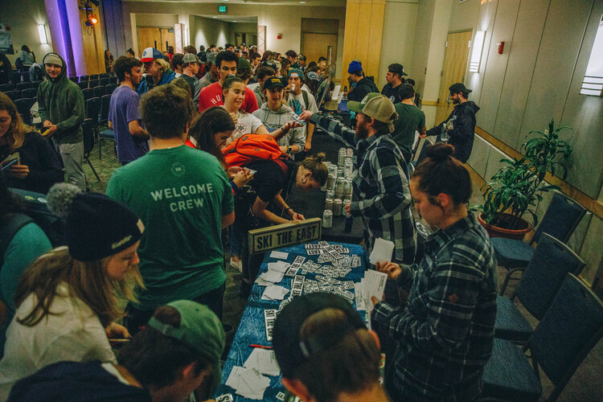
UVMSSC Ambassador Program
Want to get more involved in the club?
Want to help out with events? Rail Jams, movie premiers, marketing?
Program will launch soon so look out for emails with the application!
More info to come...

Slide 12
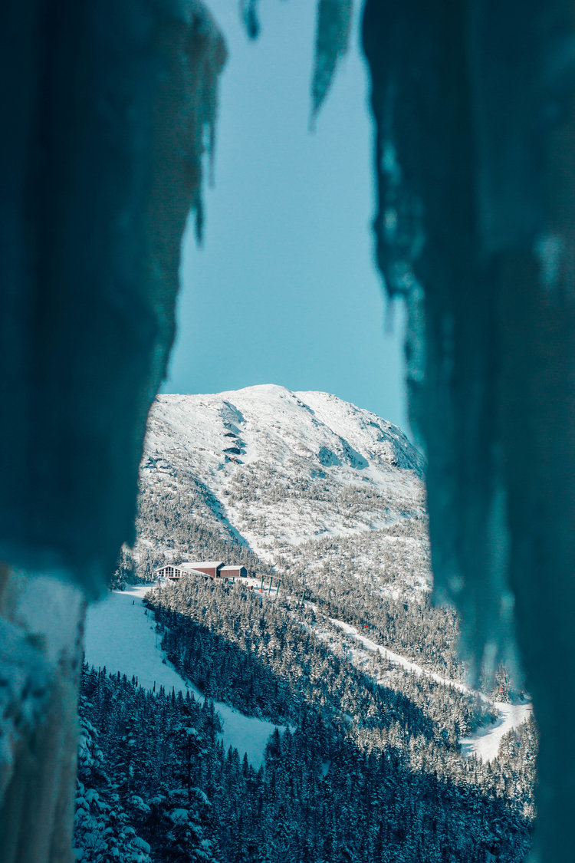
Pass Sales!
Must have 2021/22 membership to access discounted passes
- Deadline: 11/12
- Don't wait until the last minute!
- Pass Pickup Night: 11/17
- Questions? Check out our website or stop by the clubhaus!

Slide 13
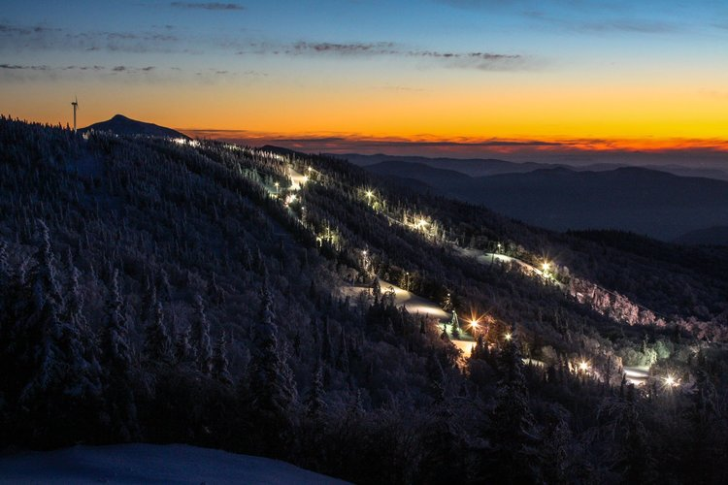
Bolton Valley
Bolton Valley Night Pass: $199
Bolton Valley Young’n Pass: $269
- 30 minutes from campus
- Only mountain that offers night skiing
- 1,704ft vertical drop

Slide 14
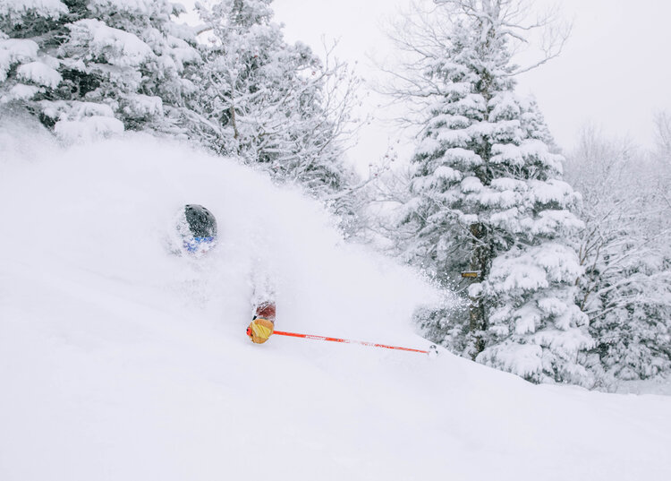
Jay Peak
Jay Peak Only: $249
2-Year Jay Peak Pass: $319
Freshman Only Pass: $129
Jay Peak + Burke: $289
- About 1 hour and 20 minutes from campus
- Largest average annual snowfall in the East and only aerial tram in Vermont
- 1815ft vertical

Slide 15
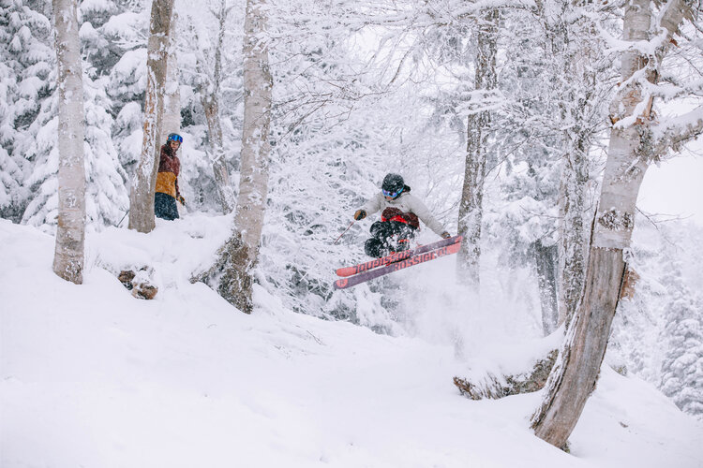
Mad River Glen
Mad River Twixter Pass: $279
Valley Double Major Pass: $429
- About 55 minutes from campus
- Known for their Single Chair
- 2037ft vertical drop

Slide 16
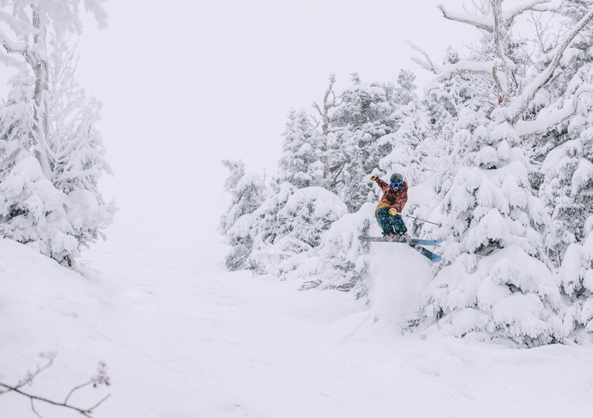
Sugarbush
Sugarbush Value College Pass: $309
Sugarbush Premium College Pass: $389
Valley Double Major Pass: $429
- About an hour from campus
- Has the longest (and one of the fastest) detachable lifts in the world
- 2600ft vertical drop

Slide 17
Smugglers Notch
Smugglers' Notch College Pass: $199
- About 55 minutes from campus
- Only triple black diamond in the East
- 2610ft vertical drop

Slide 18
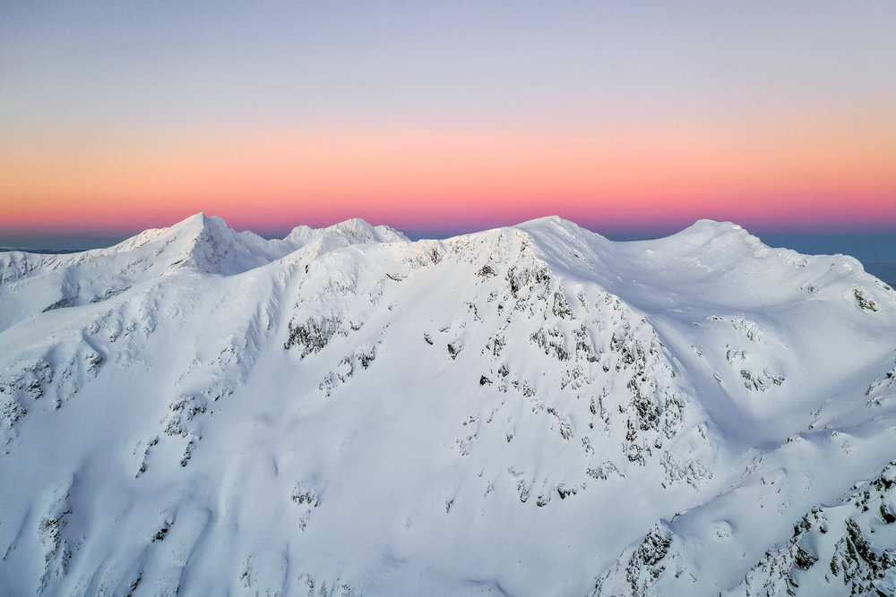
Learn to Ski & Ride Days
- Discounted lessons, lift tickets, and rentals for beginners
- If you attend 3/5 days:
- $69 season pass
- $89 season rental

Slide 19
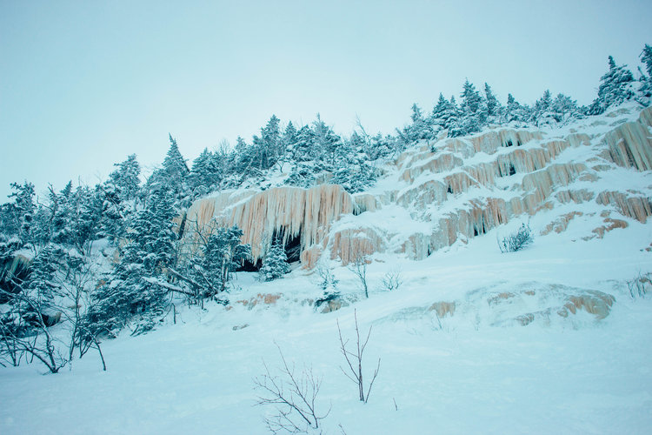
Ikon Pass
Ikon Pass Originally...
Ikon Base Pass: $729
Full Ikon Pass: $999
College Ikon Pass
Ikon Base Pass: $449
Full Ikon Pass: $619
Goes On Sale Tomorrow, ends 11/10!!

Slide 20
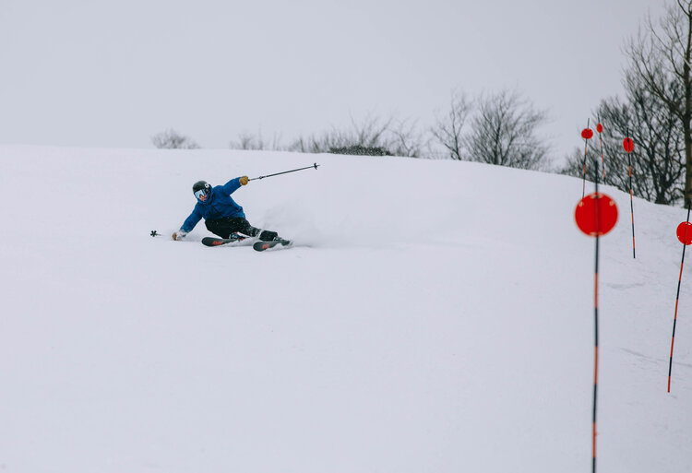
East Coast Avalanche Education Course
-2 Groups
-February 3-6 & Feburary 10-13
-1st two days are in the classroom
-Saturday & Sunday are in the field
-Get your Avy Safety 1, very helpful for the backcountry

